Slide 1


Water and Electricity Tracking App (PSC_110)
Presidency University
PIP4004 Capstone Project
Review-0
Batch Number: 118
Under the Supervision of,
Dr. Abdul Khadar A
Associate Professor
School of Computer Science and Engineering
Presidency University
Roll Number 20211CSE0636 20211CSE0699 20211CSE0658 | Student Name Soujanya S Badawadagi Bugga Iswarya Nirmala.R
Name of the Program: CSE
Name of the HoD:Dr.Asif Mohammed H.B
Name of the Program Project Coordinator: Mr. Amarnath J.L & Dr. Jayanthi. K.
Name of the School Project Coordinators: Dr. Abdul Khadar A

Slide 2
Introduction
Title :
Water and Electricity Tracking App (PSC_110)
Abstract:
Objective: To develop a mobile application that tracks water and electricity usage, helping users set consumption goals and adopt efficient resource usage habits.
Problem Statement: Rising resource consumption demands innovative solutions to promote sustainability and reduce wastage through real-time tracking and behavioral interventions.
Methodology: The app leverages real-time data tracking, Firebase for backend support, goal-setting features, and behavioral nudges informed by global best practices. It also includes data visualization to analyze trends effectively.
Outcome: A fully functional mobile application that empowers users to monitor, analyze, and reduce water and electricity usage, promoting environmental sustainability.

Slide 3
Literature Review
Resource Tracking Apps: Studies on apps tracking water and electricity usage to promote resource efficiency.
Behavioral Nudges: Research on nudging techniques (reminders, goal-setting) to encourage sustainable resource use.
Data Visualization: Literature on using charts and graphs in apps to visualize energy and water consumption trends.
IoT Integration: Research on IoT-enabled mobile apps for real-time monitoring of resource consumption.
Gamification: Studies on using gamification (rewards, progress tracking) to motivate users towards resource conservation.

Slide 4
Literature Review
Research Papers:
https://link.springer.com/article/10.1007/s43621-024-00618-3
https://papers.ssrn.com/sol3/papers.cfm?abstract_id=4264945
https://www.researchgate.net/publication/358795459_Analysis_of_Personal_Data_Visualization_Reviews_On_mHealth_Apps_short_paper
https://www.researchgate.net/publication/372971016_Understanding_User_Perspectives_on_Data_Visualisation_in_mHealth_Apps_A_Survey_Study
https://oaepublish.com/articles/jsegc.2020.03
https://pmc.ncbi.nlm.nih.gov/articles/PMC8584752/
https://link.springer.com/article/10.1007/s42979-023-02457-x
https://onlinelibrary.wiley.com/doi/10.1155/2021/3740476
https://www.ncbi.nlm.nih.gov/pmc/articles/PMC9738046/
https://www.sciencedirect.com/science/article/pii/S2352550922000874

Slide 5
Literature Review
https://www.jmir.org/2022/2/e31363/
https://pmc.ncbi.nlm.nih.gov/articles/PMC10516489/
https://pmc.ncbi.nlm.nih.gov/articles/PMC8982784/
https://www.frontiersin.org/articles/10.3389/fpsyg.2020.01385/full
https://www.darden.virginia.edu/sites/default/files/inline-files/RaveendhranFast_2021_BehaviorTrackingAcceptance.pdf
https://www.ncbi.nlm.nih.gov/pmc/articles/PMC8584752/
https://link.springer.com/article/10.1007/s43621-024-00618-3
https://journals.sagepub.com/doi/full/10.1177/21582440211043707

Slide 6
Objectives
Primary Objectives
Real-Time Monitoring: Continuously track water and electricity usage to provide users with live data on their consumption.
Consumption Goals: Enable users to set daily, weekly, or monthly consumption targets for water and electricity and monitor their progress toward achieving these goals.
Behavioral Nudges: Deliver actionable tips, reminders, and notifications to encourage users to adopt resource-efficient habits and stay within their set goals.
Secondary Objectives
Usage Visualization: Provide clear and interactive graphs, charts, and summaries to help users understand their consumption patterns over time. This will highlight trends and areas for improvement.
Educational Resources: Share global best practices for water and electricity conservation through in-app content, including tips, articles, and videos.
Sustainability Impact: Encourage long-term changes by showcasing the environmental and financial benefits of conserving resources, such as reduced carbon footprint and lower utility bills.
Community Engagement: Include features for users to share their conservation achievements and tips with others, fostering a community of sustainable living.

Slide 7
Methodology
Development Tools:
Language: Java
Platform: Android Studio
Backend: Firebase for real-time data storage and synchronization.
Database: Firebase Realtime Database for storing usage data.
Development Approach:
Requirement Gathering: Define user needs and key app features.
UI/UX Design: Simple, intuitive design for easy navigation and data interpretation.
Backend Development: Implement real-time tracking of water and electricity consumption using Firebase.
User Feedback: Collect early feedback and improve the app based on user testing.

Slide 8
Conclusion
Resource Monitoring: The app effectively tracks water and electricity usage in real time, enabling users to stay aware of their consumption.
Goal-Oriented Approach: Users can set and monitor consumption goals to achieve sustainable usage patterns.
Behavioral Nudges: The app encourages efficient resource usage by providing timely notifications, reminders, and actionable tips.
Data Visualization: Interactive graphs and analytics allow users to identify consumption trends and make informed decisions.
Educational Value: The app educates users on global best practices for resource conservation, promoting sustainable living.
Environmental Impact: By reducing resource wastage, the app contributes to environmental protection and sustainability goals.
User Empowerment: The app empowers individuals to take responsibility for their resource usage, making a positive impact on their household and community.

Slide 9
Timeline of Project

Slide 10
References
IEEE Xplore: https://ieeexplore.ieee.org/document/XXXXXXX
Google Scholar: https://scholar.google.com/
ResearchGate: https://www.researchgate.net/
Energy Efficiency Research: https://www.iea.org/reports/energy-efficiency
World Bank - Water Conservation: https://www.worldbank.org/en/topic/water
MPAndroidChart Documentation: https://github.com/PhilJay/MPAndroidChart

Slide 11
Github Link
Github Link
https://github.com/Nirmala8645/Water-and-Electricity-Tracking-App-.git

Slide 12
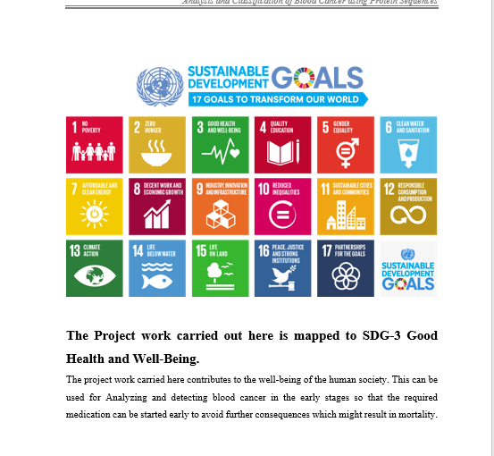
Project work mapping with SDG

Slide 13
Thank You

